Slide 1



Journey PPT
Tanishqa Aggarwal
04 Sep 2023 - 08 Sep 2023
Week 3

Slide 2


Day 1
Blob Storage
04 Sep 2023
It is used to store unstructured data like documents, images, videos, and backup files.
Azure Storage
Azure Storage is a cloud-based storage service offered by Microsoft Azure, a popular cloud computing platform. It provides scalable and secure storage solutions for a wide range of data types, including structured, unstructured, and semi-structured data. Azure Storage is a fundamental component of many cloud-based applications and services.
Table Storage
It is a NoSQL data store suitable for semi-structured data.
Queue Storage
It is a messaging service that enables communication between different parts of your application.
File Storage
It provides fully managed file shares that can be accessed using the SMB (Server Message Block) protocol.

Slide 3
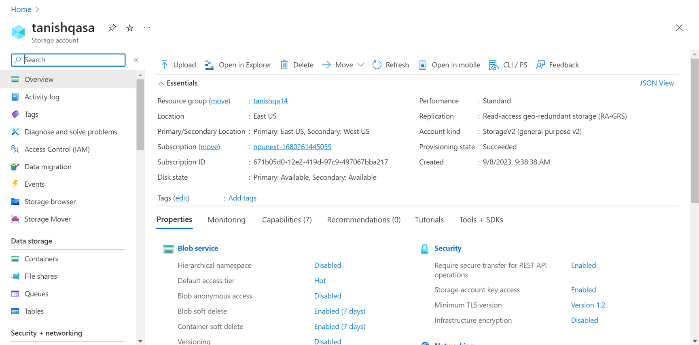
Day 2
05 Sep 2023
Azure Storage (part 2)
Azure Storage Account

Slide 4
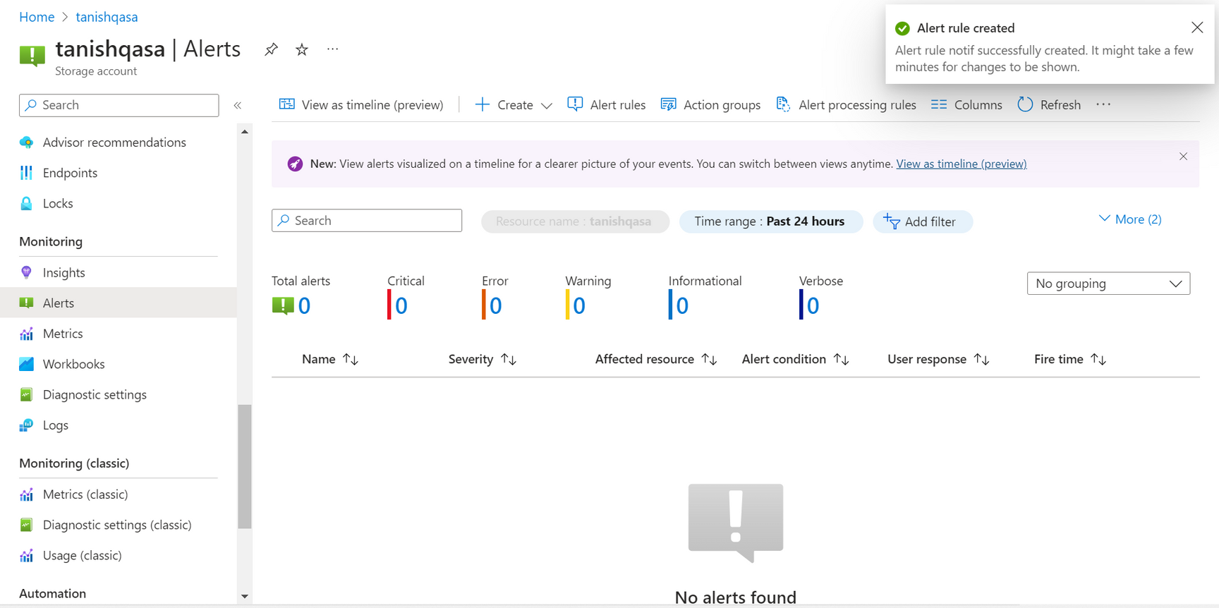
Day 2
05 Sep 2023
Azure Storage (part 2)
Creating Alert Rules

Slide 5
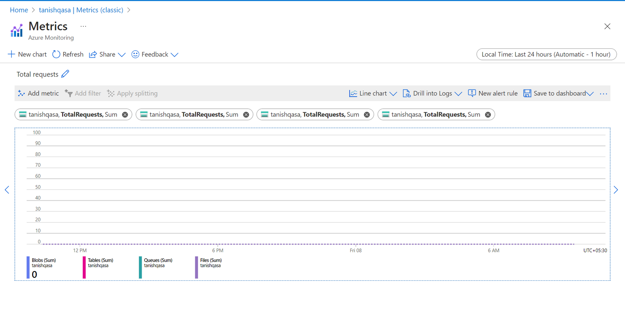
Day 2
05 Sep 2023
Azure Storage (part 2)
Working with metrics

Slide 6

Day 3
06 Sep 2023
Azure Data Factory
Azure Data Factory is a cloud-based data integration service provided by Microsoft Azure. It allows you to create, schedule, and manage data-driven workflows for orchestrating and automating the movement and transformation of data from various sources to various destinations, both within and outside Azure. Azure Data Factory is designed to help organizations manage their data pipelines efficiently, making it a critical component for modern data engineering and data analytics workflows.

Slide 7
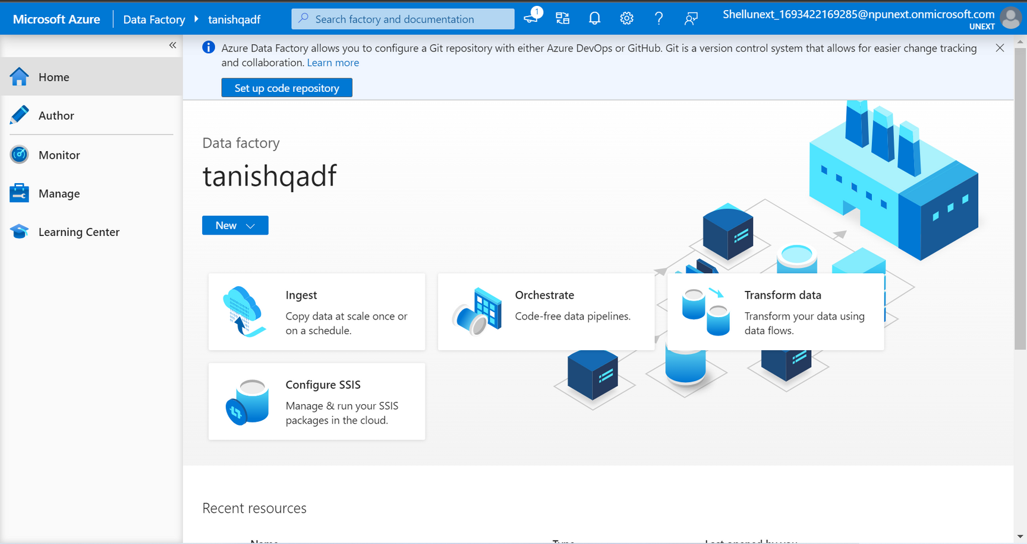
Day 3
06 Sep 2023
Azure Data Factory
Azure Data Factory

Slide 8
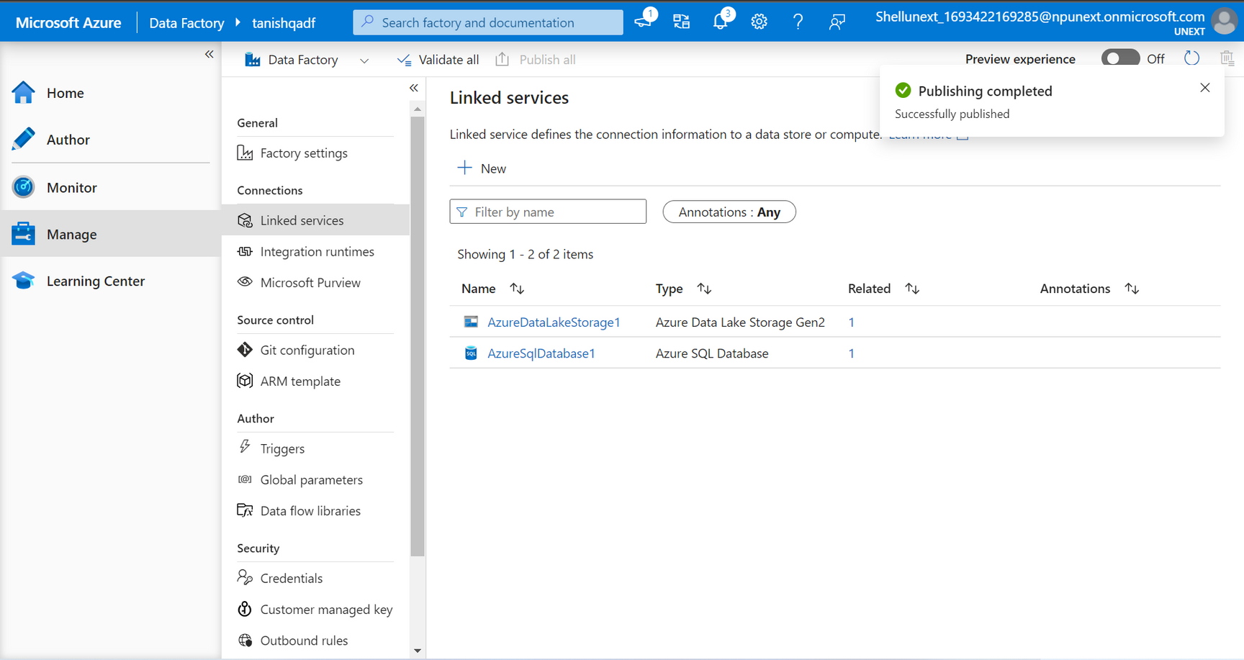
Day 3
06 Sep 2023
Azure Data Factory
Linked Services

Slide 9
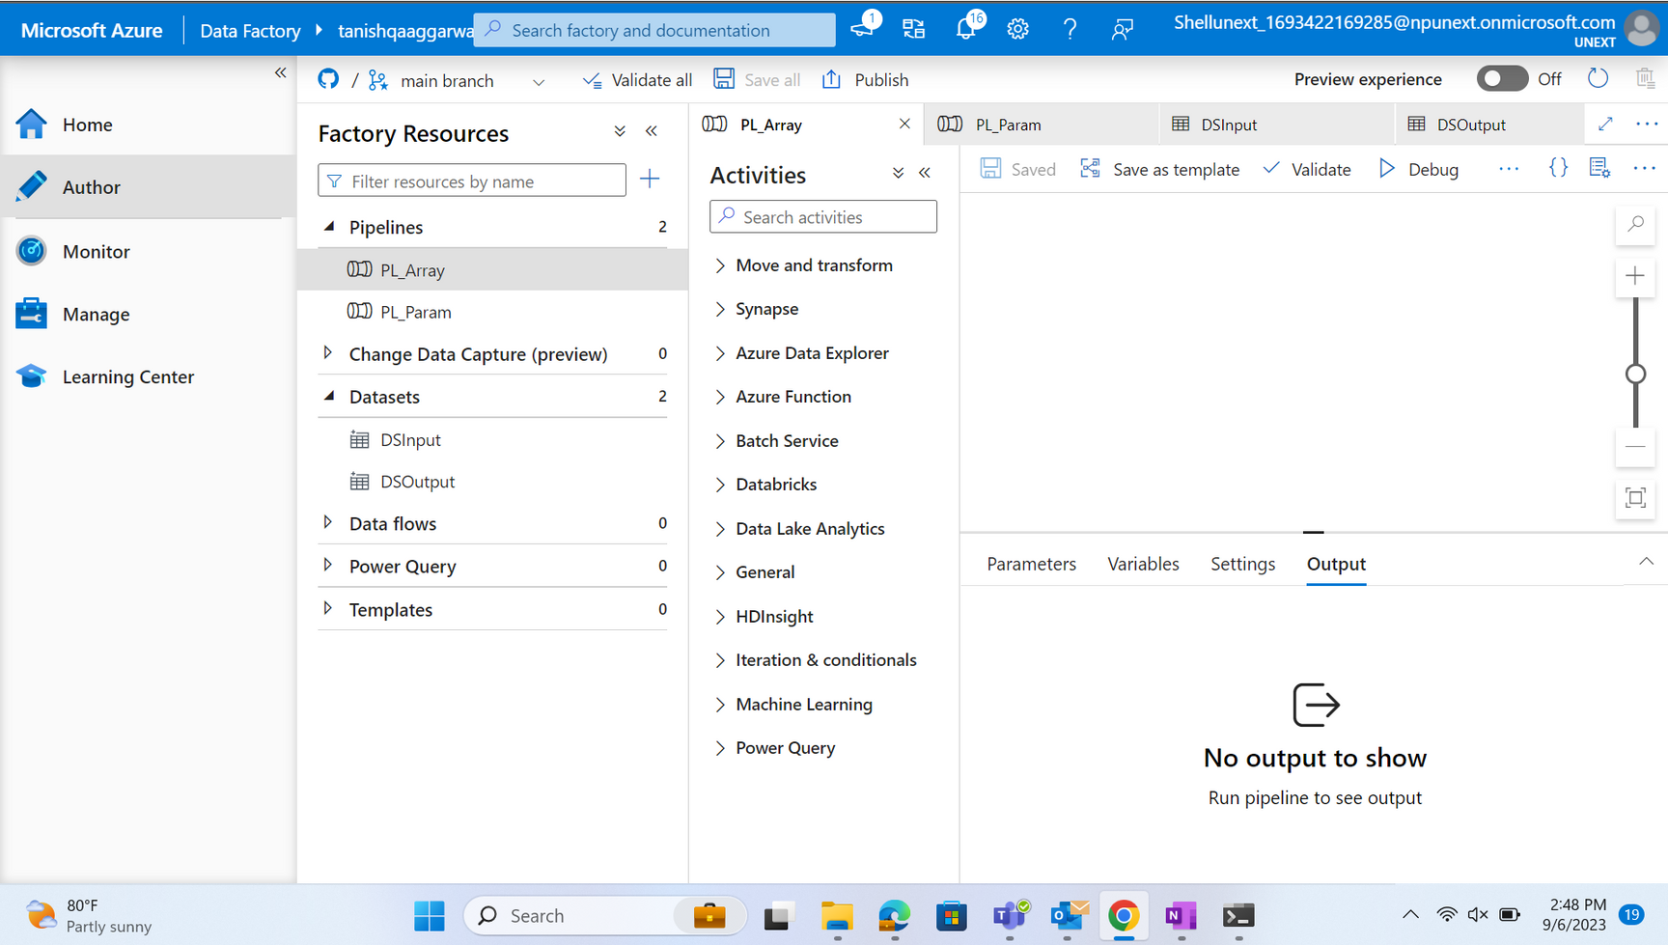
Day 3
06 Sep 2023
Azure Data Factory
Pipelines

Slide 10
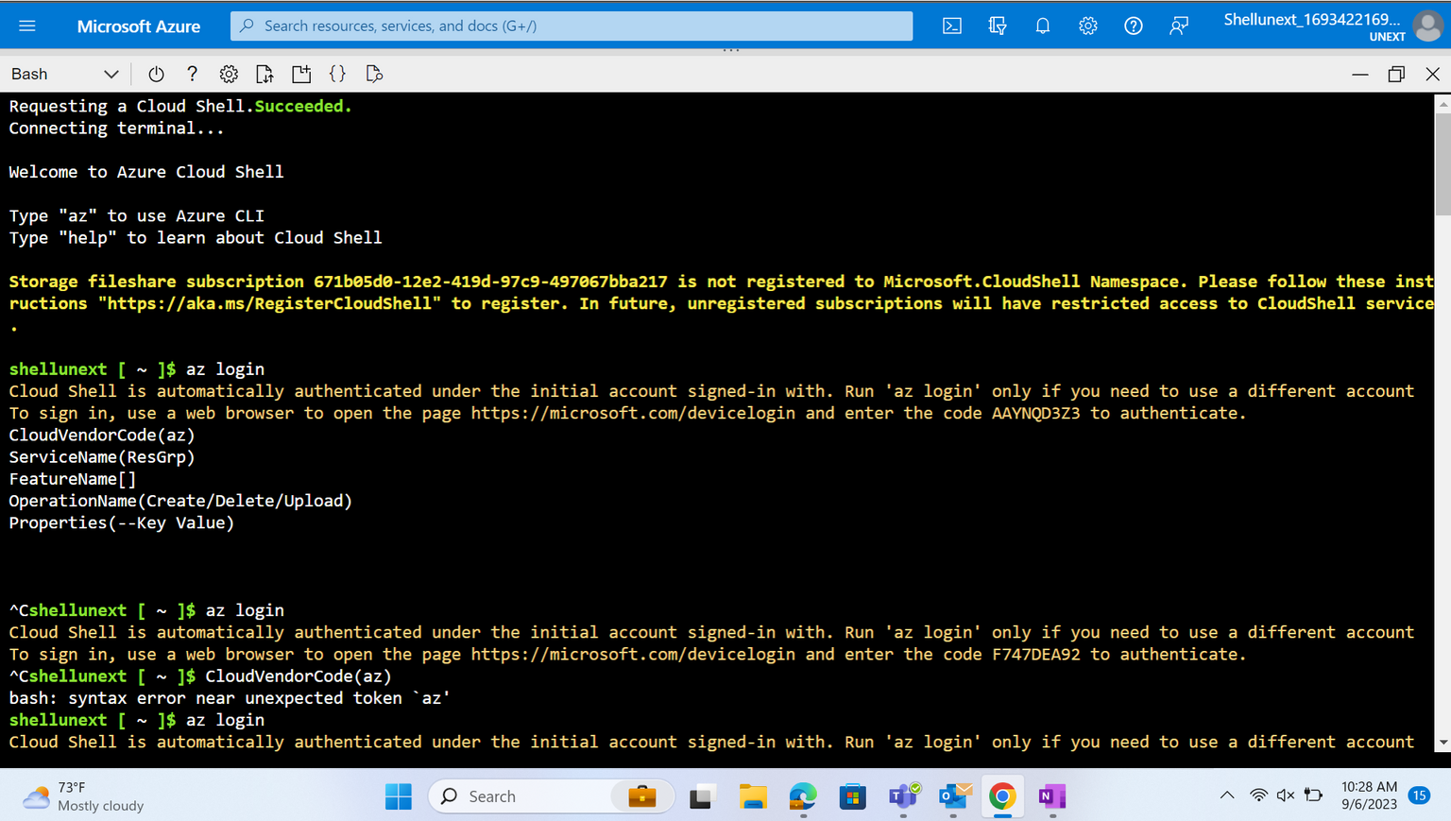
Day 4
07 Sep 2023
Azure Data Factory (part 2)
Creating Resource Group Using Bash

Slide 11
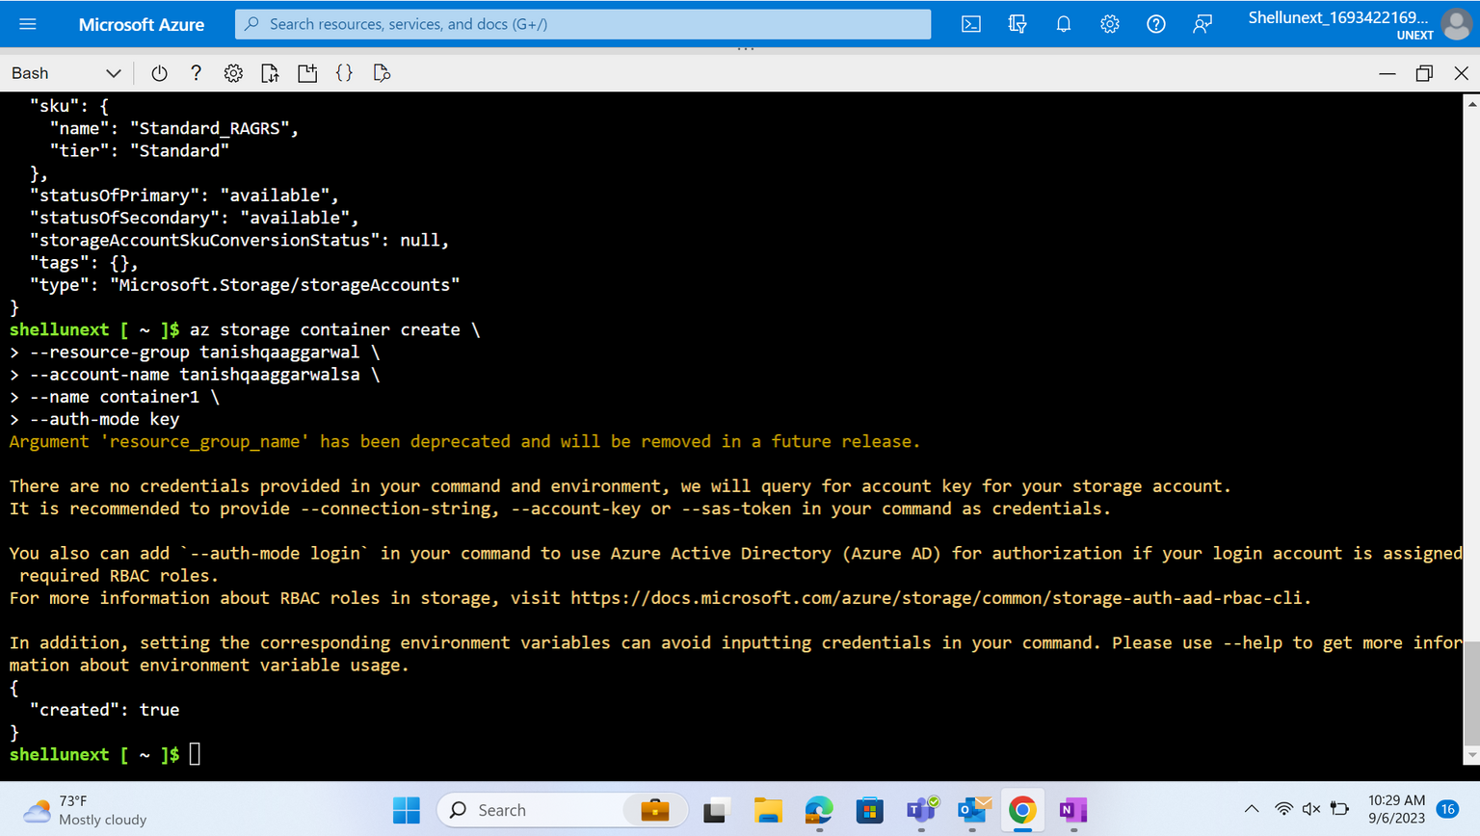
Day 4
07 Sep 2023
Azure Data Factory (part 2)
Creating Storage Account Using Bash

Slide 12
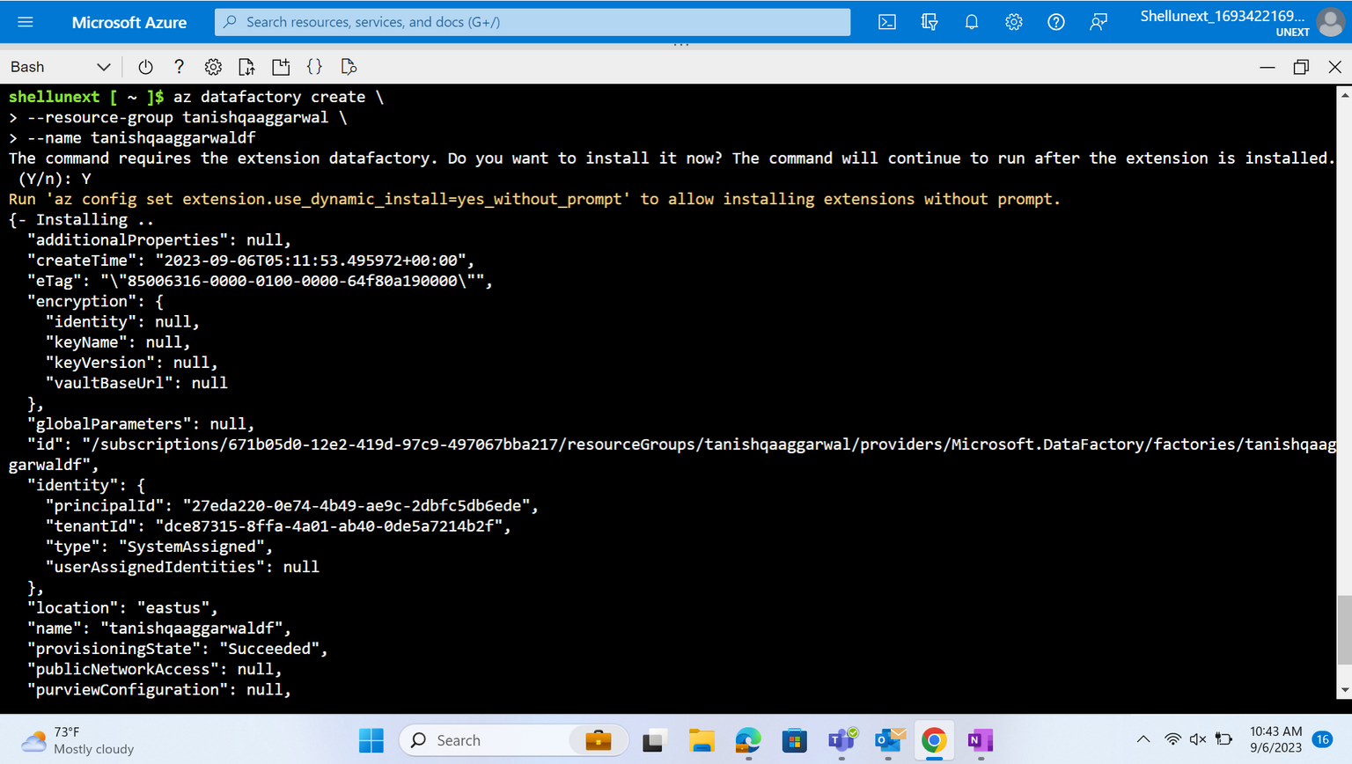
Day 4
07 Sep 2023
Azure Data Factory (part 2)
Creating Data Factory Using Bash

Slide 13
Day 4
07 Sep 2023
Azure Data Factory (part 2)
Creating Data Factory Using Bash

Slide 14
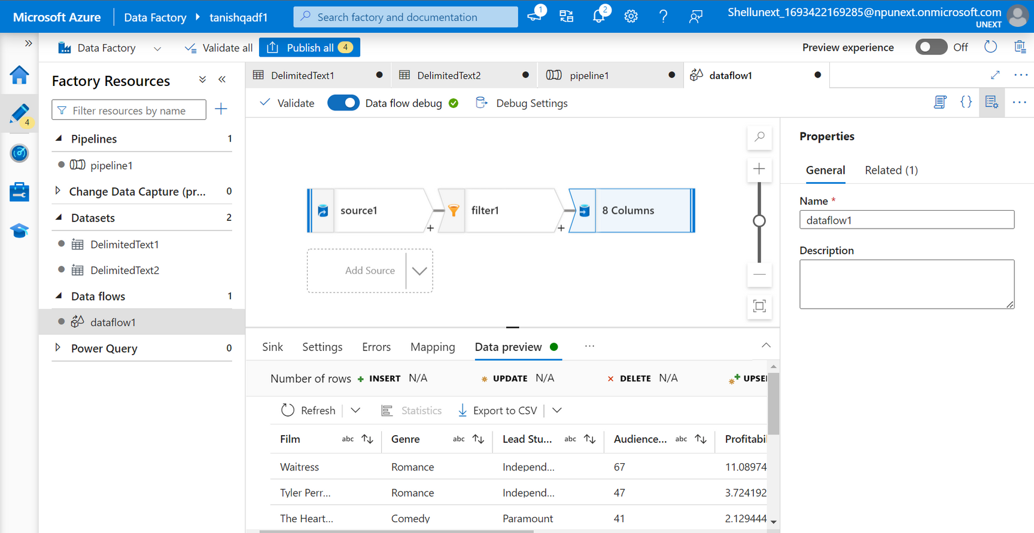
Day 4
07 Sep 2023
Azure Data Factory (part 2)
Creating Dataflow(csv to csv) In Data Factory

Slide 15
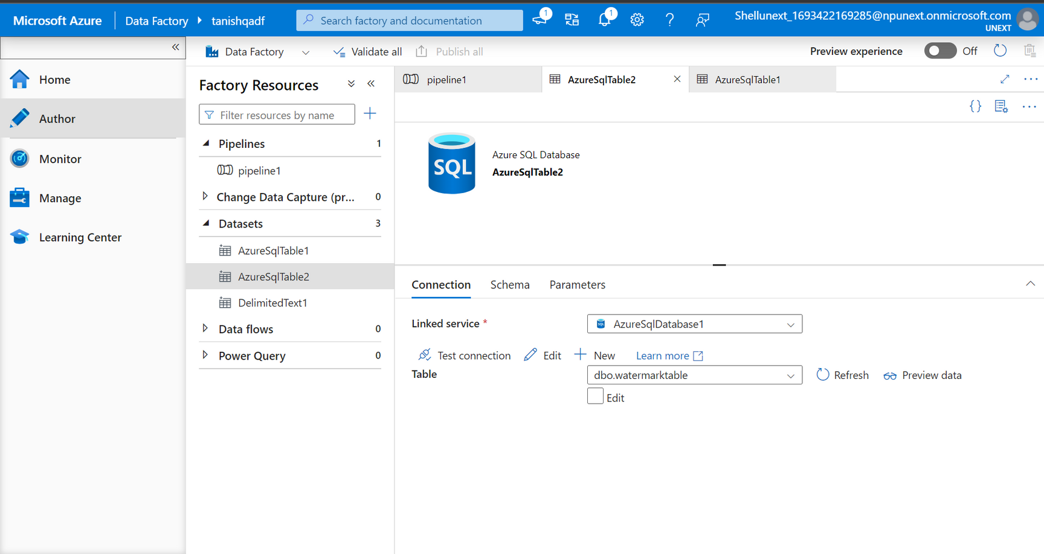
Day 5
08 Sep 2023
Azure Data Factory (part 3)
Creating Datasets In Data Factory (to fetch data from database

Slide 16
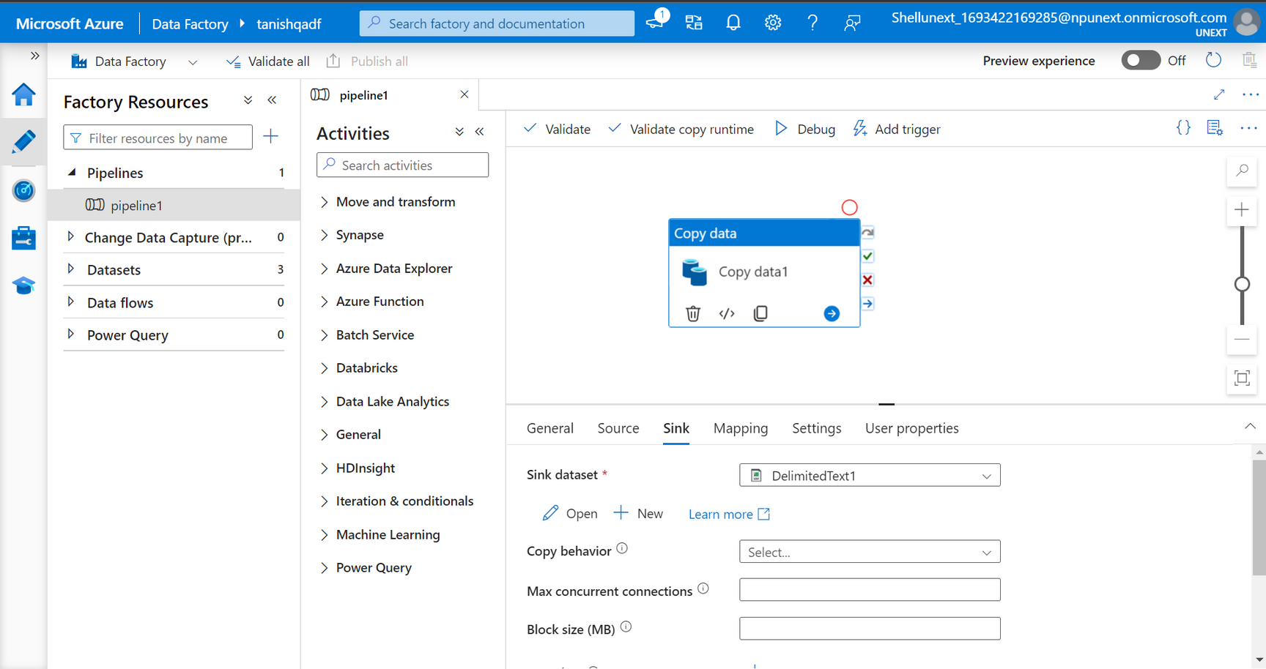
Day 5
08 Sep 2023
Azure Data Factory (part 3)
Creating Pipeline (database to storage account) In Data Factory

Slide 17

Thank You

